Slide 1
Coursera Capstone PRoject IBM Applied data science capstone
Opening a New Korean Restaurant in Northern Virginia, USA
By: Espen Matel
January 2021

Slide 2
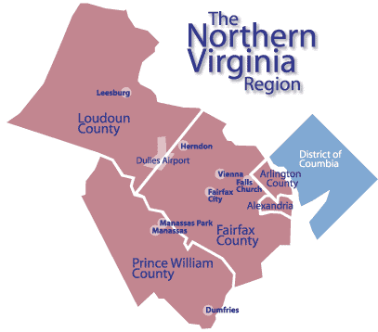
Introduction
Northern Virginia, the suburbs just outside of Washington D.C., contain an estimated 3,159,639 residents.
The Asian population is roughly 5-6% of the total US population.
The Asian population is roughly 10-12% of the total population in Northern Virginia, with some cities (e.g., Annandale) having over 20% of the population identifying as Asian.
Given this population distribution, there is a high frequency of Asian restaurants in the area and an increasingly growing customer base

Slide 3
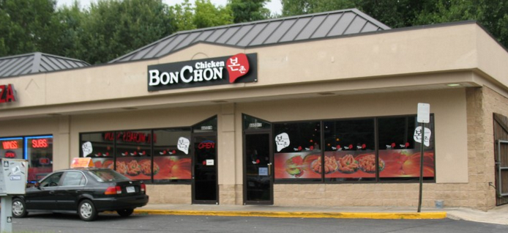
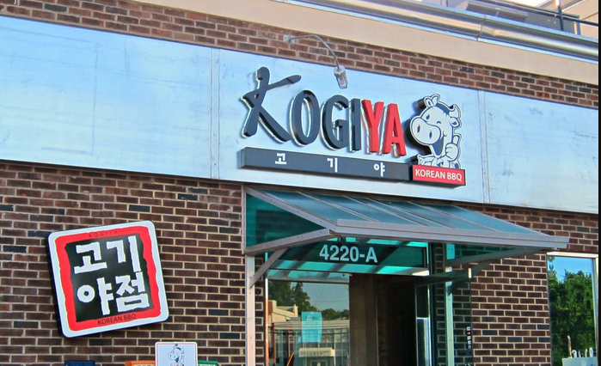
Business Problem
The goal of this analysis is to find the best location to open a Korean restaurant in Northern Virginia
Other Asian restaurants, such as Chinese, Thai, Japanese, etc., are also popular in the area and may be competitors
However, these restaurants are not equally distributed across the area, with some specific areas having a disproportionate amount of Korean restaurants, some areas with a disproportionate amount of Thai restaurants, etc.

Slide 4
Data
To answer the question, we need to retrieve the following data:
Postal Codes of Northern Virginia
Northern Virginia is narrowly defined as the counties of Arlington, Fairfax, Loudoun, and Prince William as well as the independent cities of Alexandria, Fairfax, Falls Church, Manassas, and Manassas Park.
Virginia postal codes that are not within this area will be removed
Latitude and Longitude of each postal code
Required to plot the maps and retrieve nearby venue data from Foursquare
Venue Data
To be retrieved from Foursquare API
Data to be used in k-means clustering

Slide 5
Data sources
Virginia postal codes along with associated geographical coordinates will be acquired from the following url:
https://public.opendatasoft.com/explore/dataset/us-zip-code-latitude-and-longitude/table/?refine.state=VA
Using Python requests and beautifulsoup packages, we can scrape the website and place the data into a pandas dataframe
Virginia geojson file was acquired from the following url:
https://github.com/jalbertbowden/open-virginia-gis/raw/master/zip-codes/json/zt51_d00.geojson
Venue data was retrieved from a call to Foursquare API

Slide 6
Methodology
Scrape postal code data from https://public.opendatasoft.com/
Refine data, including only postal codes within Northern Virginia
178 unique postal codes
Use postal code data in a call to Foursquare API, retrieving venue data within proximity of each postal code
A total of 16,698 venues were retrieved.
Venues that were not relevant for analysis, such as hotels, retail stores, bus stations, etc., were removed from the data
A total of 1,557 venues were selected for analysis

Slide 7
Methodology cont.
Calculated frequency counts for each venue by postal code
Data were visualized using a bar chart and choropleth maps
Data were then used in a k-means clustering algorithm, which clustered 178 postal codes into six clusters

Slide 8
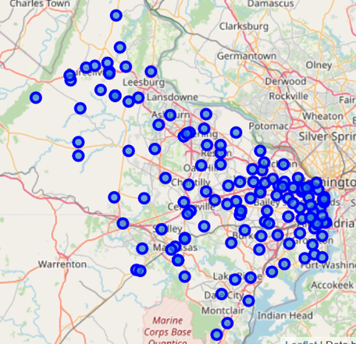
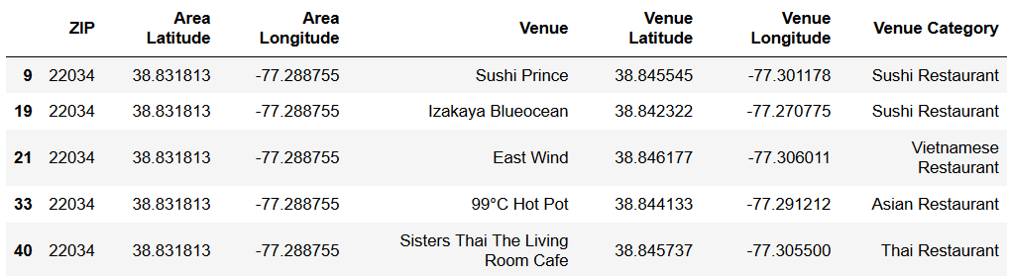
Results
After retrieving and cleaning postal code data, the data were plotted on to a map of Northern Virginia:
Notice that the areas to the west and north-west are more rural, and the areas to the east, particularly Alexandria, are denser
After calling Foursquare API for nearby venues, the results were put into a dataframe with each venue represented in a row of data:

Slide 9
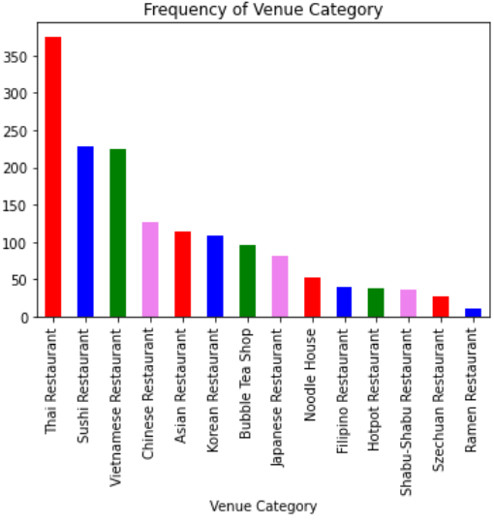
Results cont
The column “Venue Category” contains 14 unique categories.
To the right is a bar chart of the frequency of each category
Thai restaurants were most common with 376 results
Ramen restaurants were the least common with 11 results
Korean restaurants are somewhere in the middle, with 108 results
Thai, Sushi, and Vietnamese restaurants are the 3 most common Asian restaurants in Northern Virginia

Slide 10
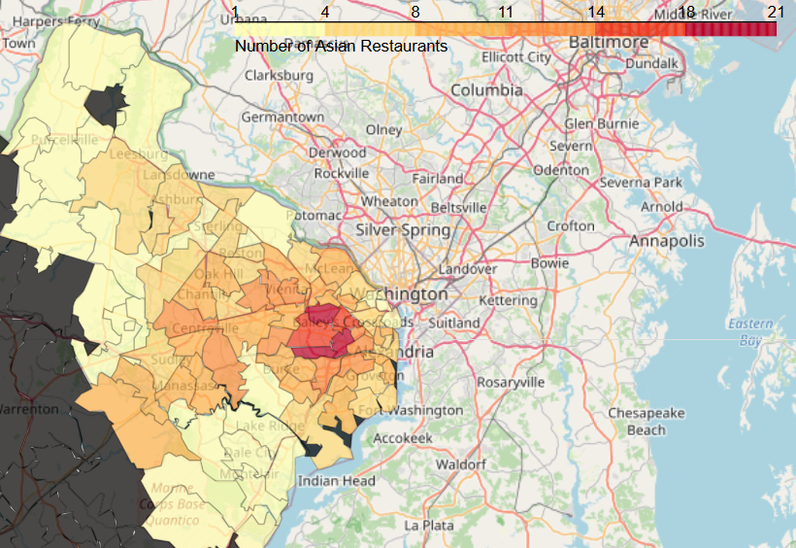
Results cont
In order to visualize the frequency of Asian restaurants and Korean restaurants by postal code, the data were processed to be plotted as a choropleth map
To the right is a choropleth map of the frequency of all Asian restaurants in Northern Virginia by postal code
While there are numerous Asian restaurants spread out over Northern Virginia, a concentration of Asian restaurants can be seen in the Centreville and Annandale areas

Slide 11
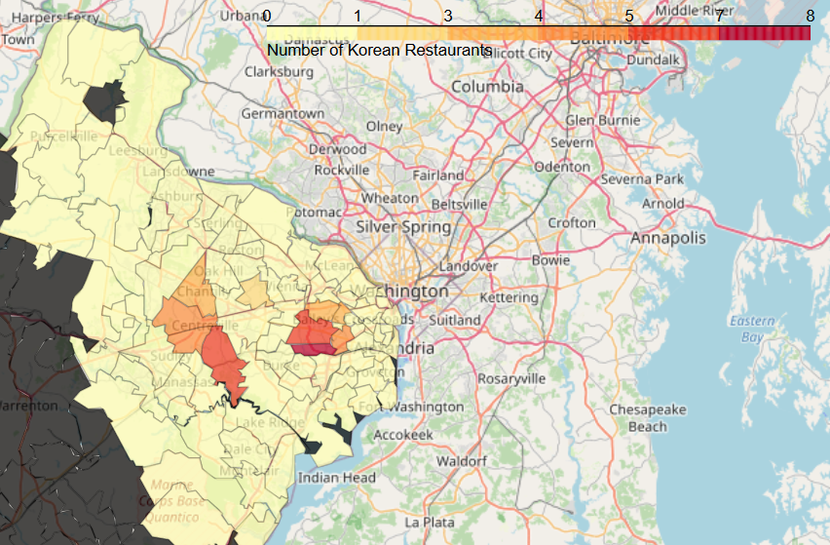
Results cont
The data were further refined to include only venues that were labeled with the category “Korean Restaurant.”
To the right is a choropleth map of the frequency of all Korean restaurants in Northern Virginia by postal code
After refining the data to include only Korean restaurants, we also see a concentration of Korean restaurants in Centreville and Annandale

Slide 12
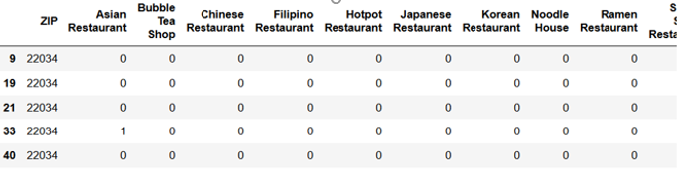
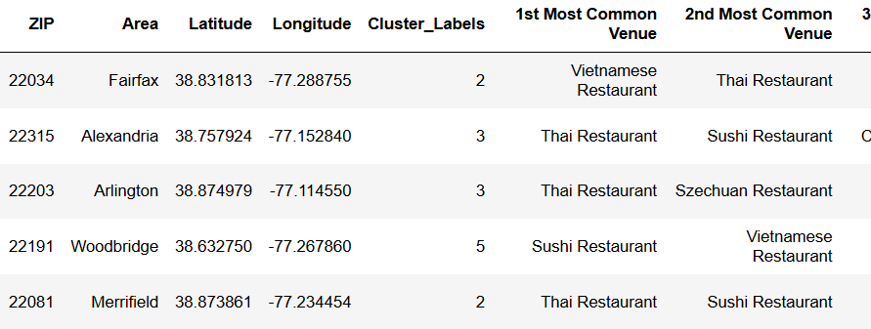
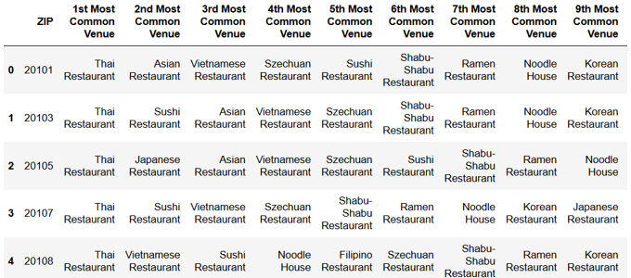
Results cont
Next, we process the data in order to employ a k-means clustering machine learning algorithm
Dummy variables were retrieved for each venue and put into a new dataframe:
Create a new dataframe that displays the postal codes along with “1st Most Common Venue” up to “10th Most Common Venue”
K-means clustering algorithm was run, and the resulting clusters were added to the dataframe:
The clusters were plotted on to a map of Northern Virginia, resulting in the visual on the next slide

Slide 13
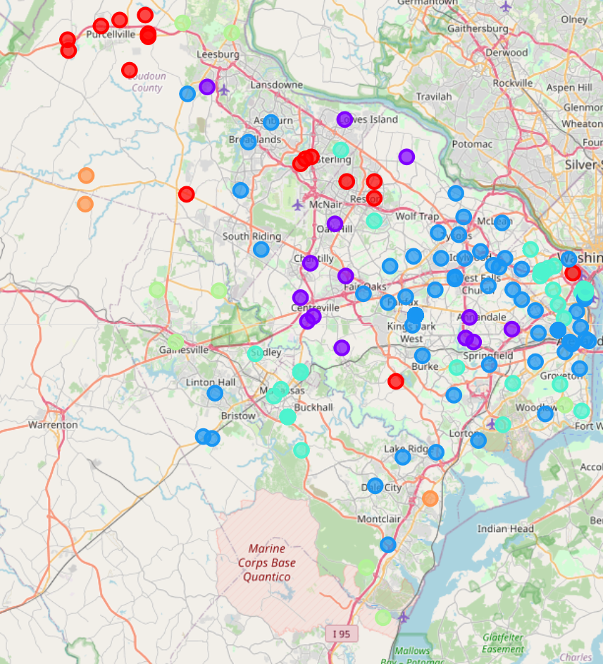
DiscussioN
Cluster 0 (Red) is most associated with the slightly more rural and less dense areas in the north-west
Annandale and Centreville, which contain a high amount of Korean restaurants, were grouped into Cluster 1 (Purple)
While most of Cluster 1 can be found around the Annandale and Centreville area, Leesburg, which is a somewhat distant north-west, was also grouped into Cluster 1
Alexandria, another area with a high density of postal codes, was mostly grouped into Cluster 2 (Blue), along with most of the suburban areas just outside Washington D.C.
Arlington, an area with a high density of postal codes, was mostly grouped into Cluster 3 (Green)
Clusters 4 (Yellowish/Mint Green) and Cluster 5 (Orange) are mostly on the far edges of Northern Virginia

Slide 14
Discussion cont.
These results could help an entrepreneur or investor select an area to look into for opening a Korean restaurant.
One area to look into is Leesburg, 20175, as this postal code was grouped into Cluster 1. Additionally, we saw on the choropleth map that this area does not have a high density of Korean restaurants as opposed to Annandale and Centreville, whom are also in Cluster 1. This suggests that there would not be as much competition from other Korean restaurants. There is also a customer base to serve in the area, as Korean restaurants are the 3rd most popular venue in Leesburg, 20175.
Additional recommendations:
Fairfax, 22033, Cluster 1
Arlington, Cluster 3

Slide 15
CONClusion
In this project, we have identified a business problem, determined what data were needed, extracted, preprocessed, and cleaned the data, visualized the data, and clustered the data using a k-means machine learning algorithm.
Lastly, recommendations were provided to address the initial question in the business problem.
These recommendations included Leesburg, Fairfax, and Arlington (Cluster 3).

Slide 16
Limitations
This analysis relies on results from a call to Foursquare API. This carries an assumption that the data from Foursquare are complete, and accurately represent the number of venues in proximity to each postal code
Variance in geography of Northern Virginia: some postal codes encapsulate a couple blocks in Arlington, while some postal codes encapsulate larger rural areas. As a result, venues retrieved for smaller and dense postal code areas may be similar
Reliance on “Venue Category” from Foursquare. Of the 1,557 venues, 114 are classified generally as “Asian restaurant.” These restaurants could either be “fusion” style restaurants that combine multiple cuisines, or that Foursquare does not have the proper venue category assigned.
Other things an entrepreneur would need to consider, such as tax codes by county, regulations by county, rent costs, etc., were not included in this analysis

